Slide 1
Chapter 10: Storage and File Structure
Overview of Physical Storage Media
Magnetic Disks
RAID
Tertiary Storage
Storage Access
File Organization
Organization of Records in Files
Data-Dictionary Storage

Slide 2
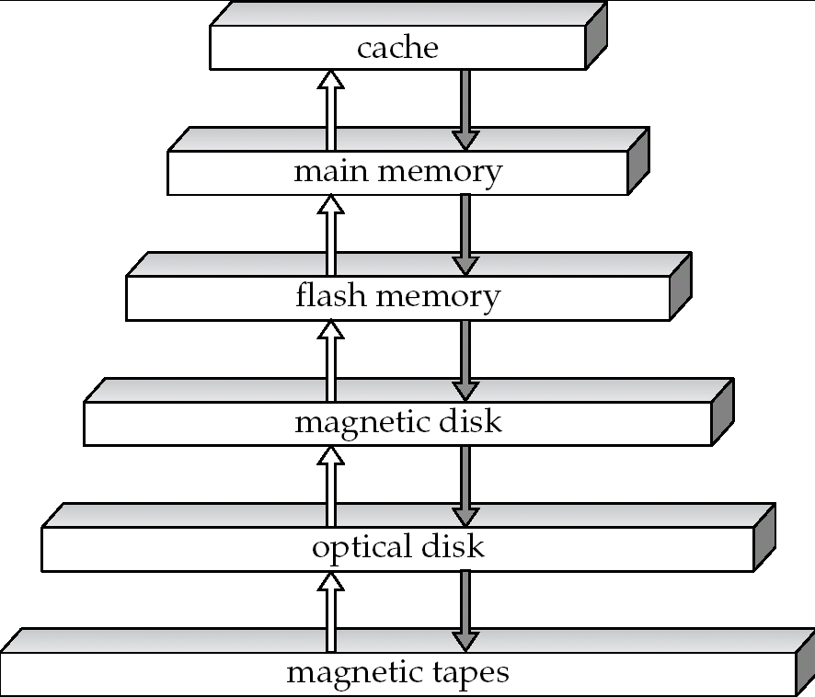
Storage Hierarchy（存储级别）
!!!
~ 1 ns
primary
storage
(一级存储)
volatile
storage
（易失存储）
!!!
~10² ns
NVM
secondary
storage
(二级存储 online
storage)
!!!
~10⁷ ns
non-volatile
storage
（非易失存储）
tertiary
storage
(三级存储
offline
storage)

Slide 3
Storage Hierarchy (Cont.)
primary storage: Fastest media but volatile (cache, main memory).
secondary storage: next level in hierarchy, non-volatile, moderately fast access time
  also called on-line storage
  E.g. flash memory, magnetic disks
tertiary storage: lowest level in hierarchy, non-volatile, slow access time
  also called off-line storage
  E.g. magnetic tape, optical storage

Slide 4
Classification of Physical Storage Media
Can differentiate storage into:
  volatile storage(易失存储): loses contents when power is switched off
  non-volatile storage（非易失存储）:
    Contents persist even when power is switched off.
    Includes secondary and tertiary storage, as well as batter- backed up main-memory.
Speed with which data can be accessed
Cost per unit of data
Reliability
  data loss on power failure or system crash
  physical failure of the storage device

Slide 5
Physical Storage Media
Cache – fastest and most costly form of storage; volatile; managed by the computer system hardware.
Main memory:
  fast access (10s to 100s of nanoseconds; 1 nanosecond = 10^{–9} seconds)
  generally too small (or too expensive) to store the entire database
    capacities of up to a few Gigabytes widely used currently
    Capacities have gone up and per-byte costs have decreased steadily and rapidly (roughly factor of 2 every 2 to 3 years)
  Volatile — contents of main memory are usually lost if a power failure or system crash occurs.

Slide 6
Physical Storage Media (Cont.)
Flash memory
  Data survives power failure
  Data can be written at a location only once, but location can be erased and written to again
    Can support only a limited number (100K – 1M) of write/erase cycles.
    Erasing of memory has to be done to an entire bank of memory
  Reads are roughly as fast as main memory
  But writes are slow (few microseconds), erase is slower
  Widely used in embedded devices such as digital cameras, phones, and USB keys

Slide 7
Physical Storage Media (Cont.)
Magnetic-disk
  Data is stored on spinning disk, and read/written magnetically
  Primary medium for the long-term storage of data; typically stores entire database.
  Data must be moved from disk to main memory for access, and written back for storage
    Much slower access than main memory (more on this later)
  direct-access – possible to read data on disk in any order, unlike magnetic tape
  Capacities range up to roughly 1.5 TB as of 2009
    Much larger capacity and cost/byte than main memory/flash memory
    Growing constantly and rapidly with technology improvements (factor of 2 to 3 every 2 years)
  Survives power failures and system crashes
    disk failure can destroy data, but is rare

Slide 8
Physical Storage Media (Cont.)
Optical storage
  non-volatile, data is read optically from a spinning disk using a laser
  CD-ROM (640 MB) and DVD (4.7 to 17 GB) most popular forms
  Blu-ray disks: 27 GB to 54 GB
  Write-one, read-many (WORM) optical disks used for archival storage (CD-R, DVD-R, DVD+R)
  Multiple write versions also available (CD-RW, DVD-RW, DVD+RW, and DVD-RAM)
  Reads and writes are slower than with magnetic disk
  Juke-box systems, with large numbers of removable disks, a few drives, and a mechanism for automatic loading/unloading of disks available for storing large volumes of data

Slide 9
Physical Storage Media (Cont.)
Tape storage
  non-volatile, used primarily for backup (to recover from disk failure), and for archival data
  sequential-access – much slower than disk
  very high capacity (40 to 300 GB tapes available)
  tape can be removed from drive ⇒ storage costs much cheaper than disk, but drives are expensive
  Tape jukeboxes available for storing massive amounts of data
    hundreds of terabytes (1 terabyte = 10⁹ bytes) to even multiple petabytes (1 petabyte = 10¹² bytes)

Slide 10

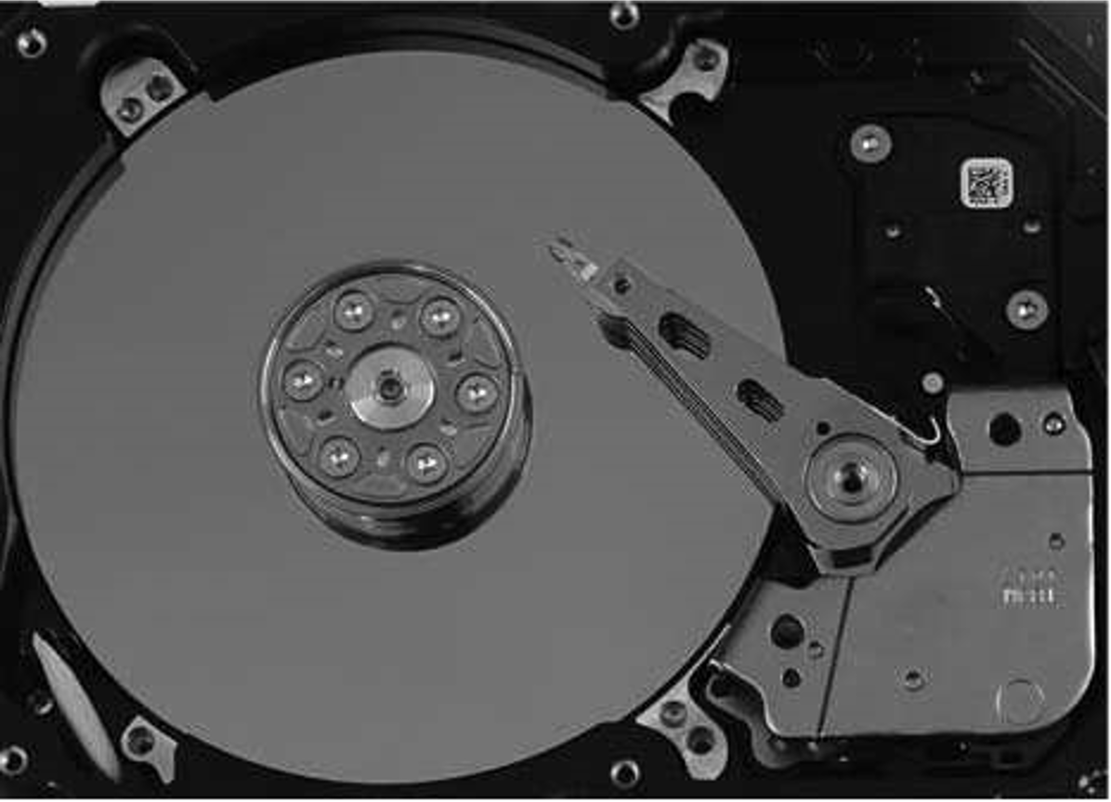
Magnetic Hard Disk Mechanism
Simplified Diagram of Disk Drives
Photo of magnetic disk drive

Slide 11
Magnetic Disks
Read-write head
  Positioned very close to the platter surface (almost touching it)
  Reads or writes magnetically encoded information.
Surface of platter divided into circular tracks（磁道）
  Over 50K-100K tracks per platter on typical hard disks
Each track is divided into sectors（扇区）.
  A sector is the smallest unit of data that can be read or written.
  Sector size typically 512 bytes
  Typical sectors per track: 500 to 1000 (on inner tracks) to 1000 to 2000 (on outer tracks)
To read/write a sector
  disk arm swings to position head on right track
  platter spins continually; data is read/written as sector passes under head
Head-disk assemblies
  multiple disk platters on a single spindle (1 to 5 usually)
  one head per platter, mounted on a common arm.
Cylinder（柱面） i consists of i^{th} track of all the platters

Slide 12

Magnetic Disks (Cont.)
Disk controller(磁盘控制器) – interfaces between the computer system and the disk drive hardware.
  accepts high-level commands to read or write a sector
  initiates actions such as moving the disk arm to the right track and actually reading or writing the data
  Computes and attaches checksums to each sector to verify that data is read back correctly
    If data is corrupted, with very high probability stored checksum won’t match recomputed checksum
  Ensures successful writing by reading back sector after writing it

Slide 13
Disk Interface Standards
Disk interface standards families
  SATA (Serial ATA)
    SATA 3 supports data transfer speeds of up to 6 gigabits/sec
  SAS (Serial Attached SCSI)
    SAS Version 3 supports 12 gigabits/sec
  NVMe (Non-Volatile Memory Express) interface
    Works with PCIe connectors to support lower latency and higher transfer rates
    Supports data transfer rates of up to 24 gigabits/sec
Disks usually connected directly to computer system
In Storage Area Networks (SAN), a large number of disks are connected by a high-speed network to a number of servers
In Network Attached Storage (NAS) networked storage provides a file system interface using networked file system protocol, instead of providing a disk system interface

Slide 14
Performance Measures of Disks
Access time(访问时间) – the time it takes from when a read or write request is issued to when data transfer begins. Consists of:
  Seek time（寻道时间） – time it takes to reposition the arm over the correct track.
    Average seek time is 1/2 the worst case seek time.
    4 to 10 milliseconds on typical disks
  Rotational latency （旋转等待时间）– time it takes for the sector to be accessed to appear under the head.
    Average latency is 1/2 of the worst case latency.
    4 to 11 milliseconds on typical disks (5400 to 15000 r.p.m.)
Data-transfer rate（数据传输率） – the rate at which data can be retrieved from or stored to the disk.
  25 to 100 MB per second max rate, lower for inner tracks
  Multiple disks may share a controller, so rate that controller can handle is also important
    E.g. SATA: 150 MB/sec, SATA-II 3Gb (300 MB/sec)
    Ultra 320 SCSI: 320 MB/s, SAS (3 to 6 Gb/sec)
    Fiber Channel (FC2Gb or 4Gb): 256 to 512 MB/s
I/O operations per second (IOPS)
  Number of random block reads that a disk can support per second
  50 to 200 IOPS on current generation magnetic disks

Slide 15
Performance Measures (Cont.)
Mean time to failure (MTTF，平均故障时间) – the average time the disk is expected to run continuously without any failure.
  Typically 3 to 5 years
  Probability of failure of new disks is quite low, corresponding to a
  “theoretical MTTF” of 500,000 to 1,200,000 hours for a new disk
    E.g., an MTTF of 1,200,000 hours for a new disk means that given 1000 relatively new disks, on an average one will fail every 1200 hours
  MTTF decreases as disk ages

Slide 16
Optimization of Disk-Block Access
Block oriented access
  Block – a contiguous sequence of sectors from a single track
  data is transferred between disk and main memory in blocks
  sizes range from 512 bytes to several kilobytes
    Smaller blocks: more transfers from disk
    Larger blocks: more space wasted due to partially filled blocks
    Typical block sizes today range from 4 to 16 kilobytes
Buffering: in-memory buffer to cache disk blocks
Read-ahead: Read extra blocks from a track in anticipation that they will be requested soon
Disk-arm-scheduling algorithms order pending accesses to tracks so that disk arm movement is minimized
  elevator algorithm:

Slide 17
Optimization of Disk Block Access (Cont.)
File organization – optimize block access time by organizing the blocks to correspond to how data will be accessed
  E.g. Store related information on the same or nearby cylinders.
  Files may get fragmented over time
    E.g. if data is inserted to/deleted from the file
    Or free blocks on disk are scattered, and newly created file has its blocks scattered over the disk
    Sequential access to a fragmented file results in increased disk arm movement
  Some systems have utilities to defragment the file system, in order to speed up file access

Slide 18
Optimization of Disk Block Access (Cont.)
Nonvolatile write buffers （非易失性写缓存）speed up disk writes by writing blocks to a non-volatile RAM buffer immediately
  Non-volatile RAM: battery backed up RAM or flash memory
    Even if power fails, the data is safe and will be written to disk when power returns
  Controller then writes to disk whenever the disk has no other requests or request has been pending for some time
  Database operations that require data to be safely stored before continuing can continue without waiting for data to be written to disk
  Writes can be reordered to minimize disk arm movement
Log disk（日志磁盘） – a disk devoted to writing a sequential log of block updates
  Used exactly like nonvolatile RAM
    Write to log disk is very fast since no seeks are required
    No need for special hardware (NV-RAM)
File systems typically reorder writes to disk to improve performance
  Journaling file systems （日志文件系统）write data in safe order to NV-RAM or log disk
  Reordering without journaling: risk of corruption of file system data

Slide 19
Flash Storage
NOR flash vs NAND flash
NAND flash
  used widely for storage, cheaper than NOR flash
  requires page-at-a-time read (page: 512 bytes to 4 KB)
    20 to 100 microseconds for a page read
    Not much difference between sequential and random read
  Page can only be written once
    Must be erased to allow rewrite
SSD(Solid State Disks)
  Use standard block-oriented disk interfaces, but store data on multiple flash storage devices internally
  Transfer rate of up to 500 MB/sec using SATA, and
  up to 3 GB/sec using NVMe PCIe

Slide 20
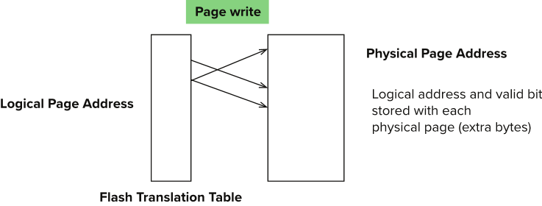
Flash Storage (Cont.)
Erase happens in units of erase block
  Takes 2 to 5 millisecs
  Erase block typically 256 KB to 1 MB (128 to 256 pages)
Remapping of logical page addresses to physical page addresses avoids waiting for erase
Flash translation table tracks mapping
  also stored in a label field of flash page
  remapping carried out by flash translation layer
After 100,000 to 1,000,000 erases, erase block becomes unreliable and cannot be used
  wear leveling
Notes:
Where is FTL stored? How is it reconstructed on system startup?
How to track number of erases per block (extra storage per block)

Slide 21
SSD Performance Metrics
Random reads/writes per second
  Typical 4 KB reads: 10,000 IOPS
  Typical 4KB writes: 40,000 IOPS
  SSDs support parallel reads
    Typical 4KB reads:
      100,000 IOPS with 32 requests in parallel (QD-32) on SATA
      350,000 IOPS with QD-32 on NVMe PCIe
    Typical 4KB writes:
      100,000 IOPS with QD-32, even higher on some models
Data transfer rate for sequential reads/writes
  400 MB/sec for SATA3, 2 to 3 GB/sec using NVMe PCIe
Hybrid disks: combine small amount of flash cache with larger magnetic disk

Slide 22
Storage Class Memory
3D-XPoint memory technology pioneered by Intel
Available as Intel Optane
  SSD interface shipped from 2017
    Allows lower latency than flash SSDs
  Non-volatile memory interface announced in 2018
    Supports direct access to words, at speeds comparable to main-memory speeds

Slide 23
File Organization, Record Organization and Storage Access

Slide 24
File Organization
The database is stored as a collection of files. Each file is a sequence of records. A record is a sequence of fields.
One approach:
  assume record size is fixed
  each file has records of one particular type only
  different files are used for different relations
  This case is easiest to implement; will consider variable length records later.

Slide 25
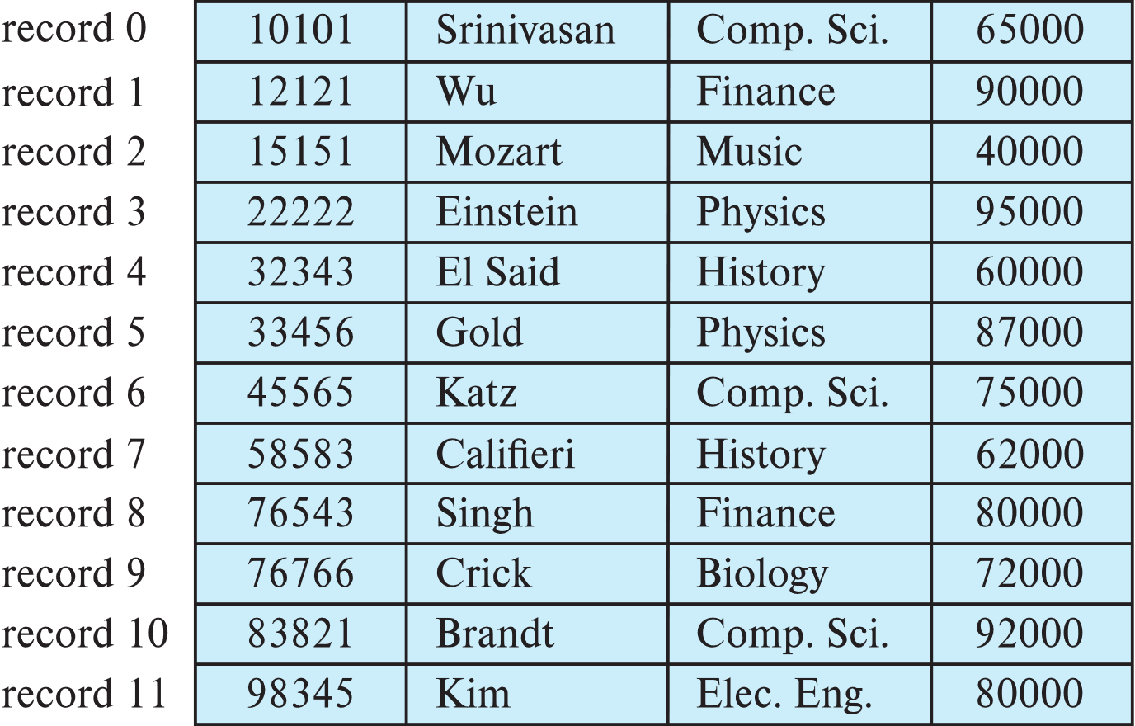
Fixed-Length Records
Simple approach:
  Store record i starting from byte n ∗ (i – 1), where n is the size of each record.
  Record access is simple but records may cross blocks
    Modification: do not allow records to cross block boundaries

Slide 26
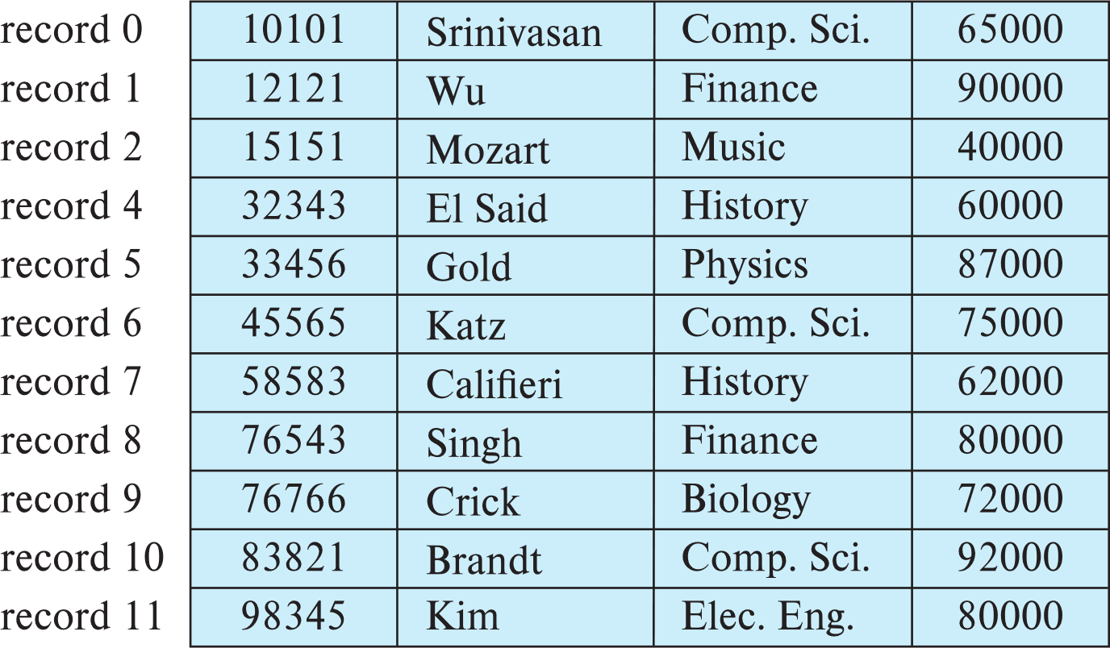
Fixed-Length Records
Deletion of record i: alternatives:
  move records i + 1, . . ., n to i, . . . , n – 1
  move record n to i
  do not move records, but link all free records on a free list
  Record 3 deleted

Slide 27
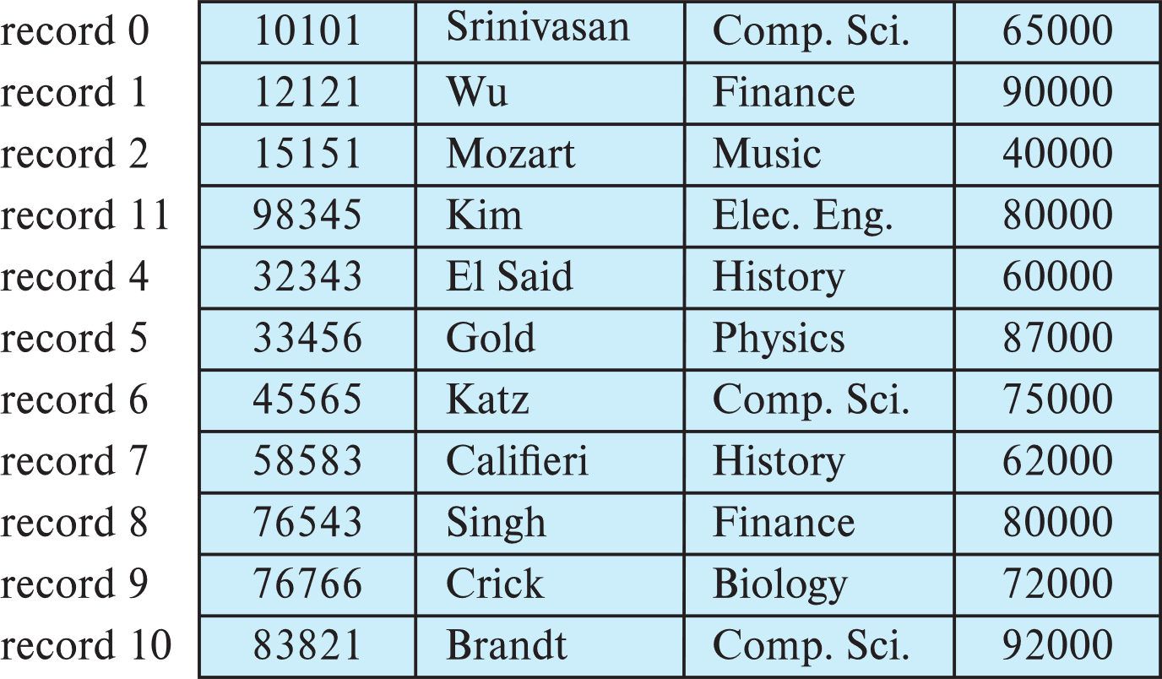
Fixed-Length Records
Deletion of record i: alternatives:
  move records i + 1, . . ., n to i, . . . , n – 1
  move record n to i
  do not move records, but link all free records on a free list
  Record 3 deleted and replaced by record 11

Slide 28
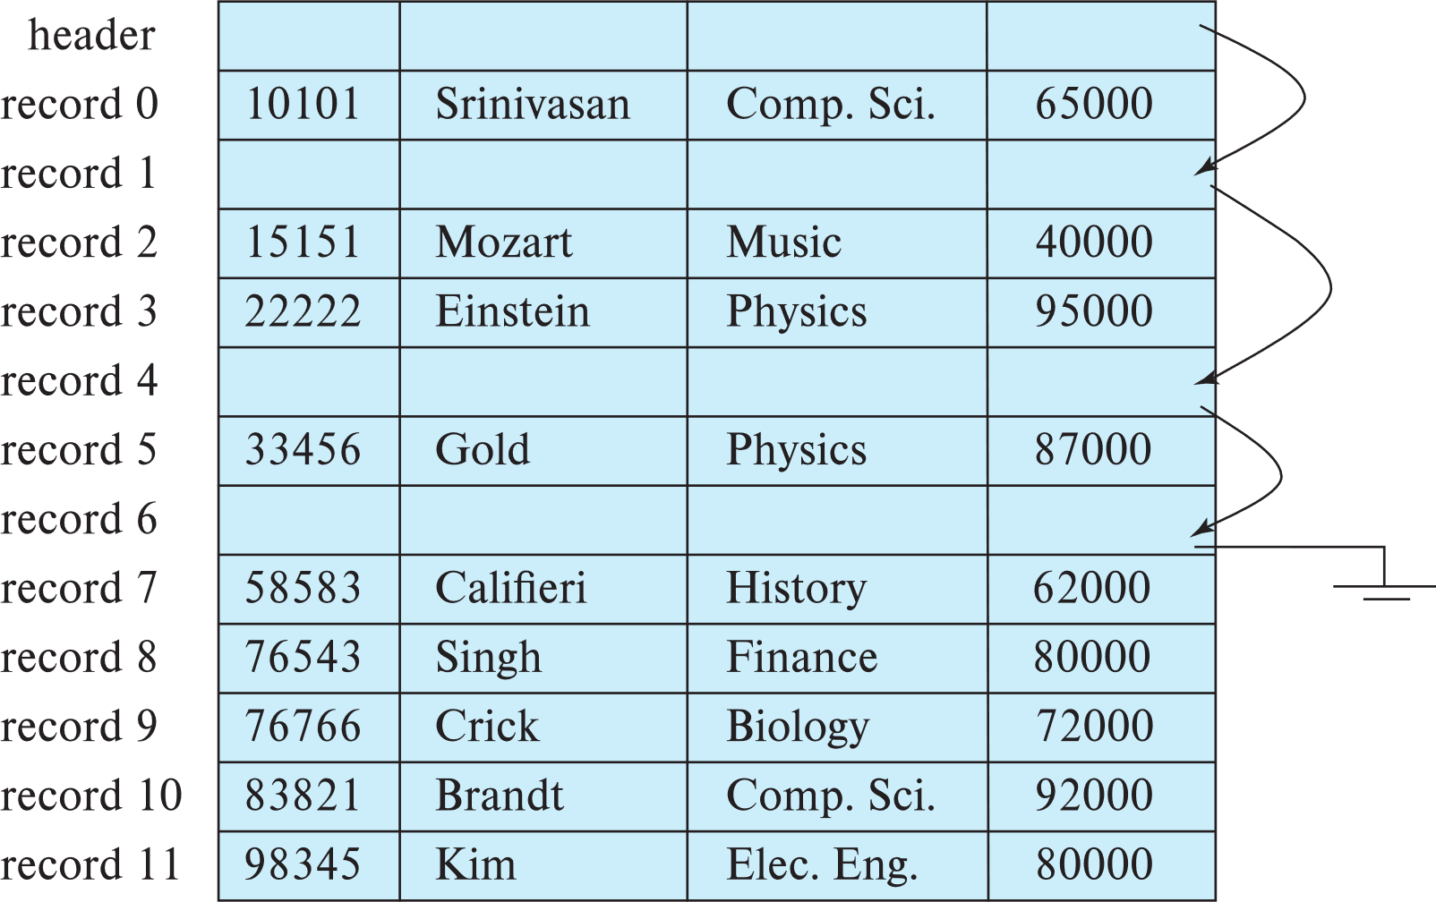
Fixed-Length Records
Deletion of record i: alternatives:
  move records i + 1, . . ., n to i, . . . , n – 1
  move record n to i
  do not move records, but link all free records on a free list

Slide 29

Variable-Length Records
Variable-length records arise in database systems in several ways:
  Storage of multiple record types in a file.
  Record types that allow variable lengths for one or more fields such as strings (varchar)
  Record types that allow repeating fields (used in some older data models).
Attributes are stored in order
Variable length attributes represented by fixed size (offset, length), with actual data stored after all fixed length attributes
Null values represented by null-value bitmap（空位图）
Instructor（id，name, dept_name, salary)

Slide 30

Variable-Length Records: Slotted Page Structure
Slotted page（分槽页） header contains:
  number of record entries
  end of free space in the block
  location and size of each record
Records can be moved around within a page to keep them contiguous with no empty space between them; entry in the header must be updated.
Record pointers should not point directly to record — instead they should point to the entry for the record in header.

Slide 31
Organization of Records in Files
Heap – record can be placed anywhere in the file where there is space
Sequential – store records in sequential order, based on the value of the search key of each record
In a multitable clustering file organization records of several different relations can be stored in the same file
  Motivation: store related records on the same block to minimize I/O
B⁺-tree file organization
  Ordered storage even with inserts/deletes
Hashing – a hash function computed on search key; the result specifies in which block of the file the record should be placed

Slide 32
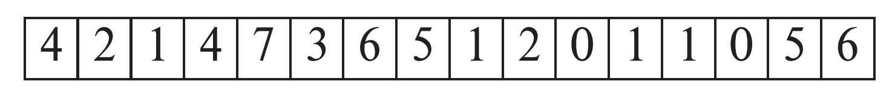
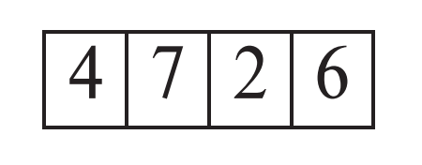
Heap File Organization
Records can be placed anywhere in the file where there is free space
Records usually do not move once allocated
Important to be able to efficiently find free space within file
Free-space map
  Array with 1 entry per block. Each entry is a few bits to a byte, and records fraction of block that is free
  In example below, 3 bits per block, value divided by 8 indicates fraction of block that is free
  Can have second-level free-space map
  In example above, each entry stores maximum from 4 entries of first-level free-space map
Free space map written to disk periodically, OK to have wrong (old) values for some entries (will be detected and fixed)
first level
second level

Slide 33

Sequential File Organization
Suitable for applications that require sequential processing of the entire file
The records in the file are ordered by a search-key

Slide 34

Sequential File Organization (Cont.)
Deletion – use pointer chains
Insertion –locate the position where the record is to be inserted
  if there is free space insert there
  if no free space, insert the record in an overflow block
  In either case, pointer chain must be updated
Need to reorganize the file
from time to time to restore
sequential order

Slide 35



Multitable Clustering File Organization
Store several relations in one file using a multitable clustering file organization
department
instructor
multitable clustering
of department and
instructor

Slide 36

Multitable Clustering File Organization (cont.)
good for queries involving join department instructor, and for queries involving one single department and its instructors
bad for queries involving only department
results in variable size records
Can add pointer chains to link records of a particular relation

Slide 37
Data Dictionary Storage
The Data dictionary (also called system catalog) stores metadata; that is, data about data, such as
Information about relations
  names of relations
  names, types and lengths of attributes of each relation
  names and definitions of views
  integrity constraints
User and accounting information, including passwords
Statistical and descriptive data
  number of tuples in each relation
Physical file organization information
  How relation is stored (sequential/hash/…)
  Physical location of relation
Information about indices (Chapter 11)

Slide 38

Relational Representation of System Metadata
Relational representation on disk
Specialized data structures designed for efficient access, in memory

Slide 39
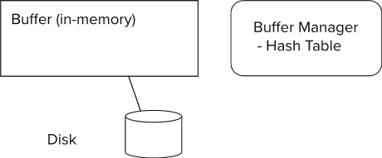
Storage Access
Blocks are units of both storage allocation and data transfer.
Database system seeks to minimize the number of block transfers between the disk and memory. We can reduce the number of disk accesses by keeping as many blocks as possible in main memory.
Buffer – portion of main memory available to store copies of disk blocks.
Buffer manager – subsystem responsible for allocating buffer space in main memory.

Slide 40
Buffer Manager in DBMS
Higher Level Access
Buffer
Main Memory
Database
Disk

Slide 41
LRU Example
Supposing there are 4 buffer pages.
Initial is empty occupied。
The access sequence is 1, 4, 8, 1, 5, 2, 3, 2, 4.
According to the LRU policy , there are 3 times replacement occurred.
Access
1 4 8 1 5 2 3 2 4
5
2
3
2
4
Buffer
8
1
1
5
2
3
2
4
4
8
8
1
5
5
3
1
1
1
4
4
8
1
1
5

Slide 42
Buffer Manager
Programs call on the buffer manager when they need a block from disk.
  If the block is already in the buffer, buffer manager returns the address of the block in main memory
  If the block is not in the buffer, the buffer manager
    Allocates space in the buffer for the block
      Replacing (throwing out) some other block, if required, to make space for the new block.
      Replaced block written back to disk only if it was modified since the most recent time that it was written to/fetched from the disk.
    Reads the block from the disk to the buffer, and returns the address of the block in main memory to requester.

Slide 43
Buffer-Replacement Policies
LRU strategy - replace the block least recently used .
  Idea behind LRU – use past pattern of block references as a predictor of future references
Queries have well-defined access patterns (such as sequential scans), and a database system can use the information in a user’s query to predict future references
  LRU can be a bad strategy for certain access patterns involving repeated scans of data
  For example: when computing the join of 2 relations r and s by a nested loops
  for each tuple tr of r do
  for each tuple ts of s do
  if the tuples tr and ts match …
Mixed strategy with hints on replacement strategy provided
by the query optimizer is preferable

Slide 44
Buffer-Replacement Policies (Cont.)
Pinned block – memory block that is not allowed to be written back to disk.
Toss-immediate strategy – frees the space occupied by a block as soon as the final tuple of that block has been processed
Most recently used (MRU) strategy – system must pin the block currently being processed. After the final tuple of that block has been processed, the block is unpinned, and it becomes the most recently used block.
Buffer managers also support forced output of blocks for the purpose of recovery (more in Chapter 16)

Slide 45
Clock: An approximation of LRU
Arrange block into a cycle, store one reference_bit per block
When pin_count reduces to 0, set reference _bit =1
reference _bit as the 2nd chance bit
0
1
1
0
1
1
1
0

Slide 46
Clock: An approximation of LRU
When replacement necessary
do for each block in cycle {
if (reference_bit ==1)
set reference_bit=0;
else if (reference_bit ==0)
choose this block for replacement;
} until a page is chosen;
0
1
0
0
0
1
0
0

Slide 47
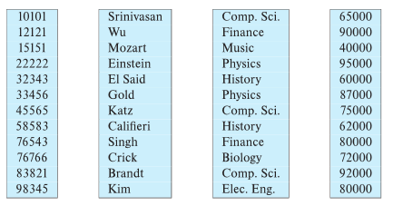
Column-Oriented Storage
Also known as columnar representation
Store each attribute of a relation separately
Example

Slide 48
Columnar Representation
Benefits:
  Reduced IO if only some attributes are accessed
  Improved CPU cache performance
  Improved compression
  Vector processing on modern CPU architectures
Drawbacks
  Cost of tuple reconstruction from columnar representation
  Cost of tuple deletion and update
  Cost of decompression
Columnar representation found to be more efficient for decision support than row-oriented representation
Traditional row-oriented representation preferable for transaction processing
Some databases support both representations
  Called hybrid row/column stores

Slide 49
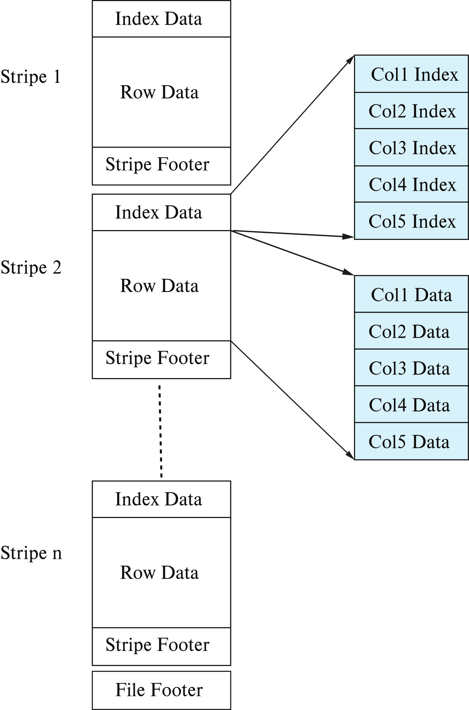
Columnar File Representation
ORC and Parquet: file formats with columnar storage inside file
Very popular for big-data applications
Orc file format shown on right:

Slide 50
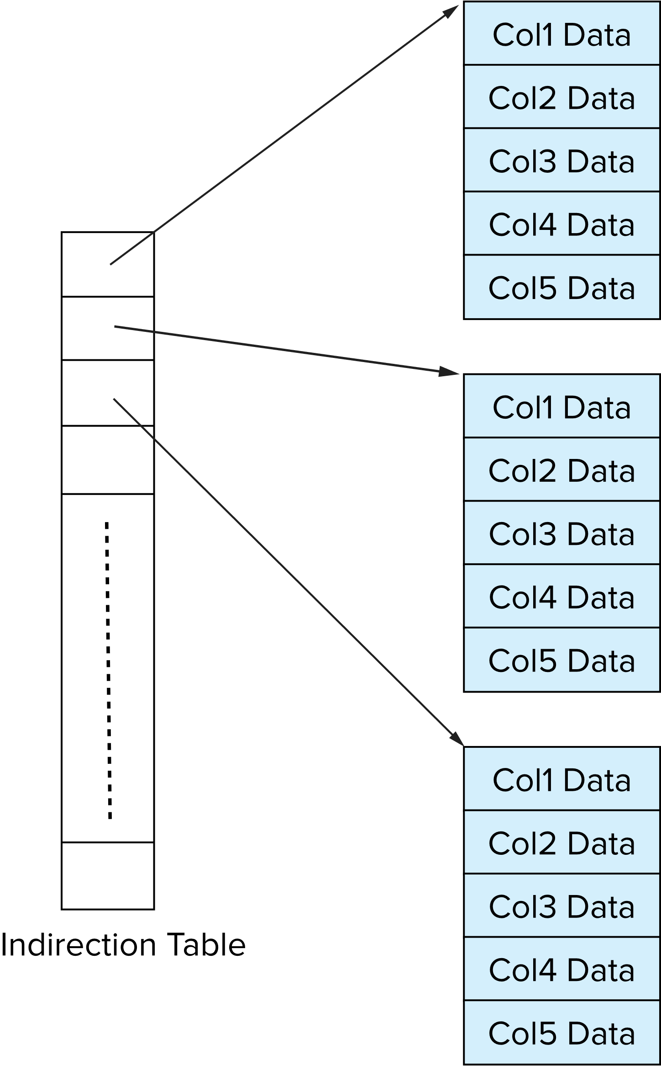
Storage Organization in Main-Memory Databases
Can store records directly in memory without a buffer manager
Column-oriented storage can be used in-memory for decision support applications
  Compression reduces memory requirement

Slide 51
End of Chapter 10

